Slide 1


Library Management System in Java
The Library Management System in Java is a comprehensive software solution designed to streamline the operations of a library. This system provides efficient methods for managing book collections, patron records, and circulation processes, making it easier for librarians to serve their community.
by Ayush Singh

Slide 2

Overview of the Project
1
Requirements Gathering
Identify the key functionality and features needed for the library management system.
2
Database Design
Develop a robust database schema to store and manage library data efficiently.
3
User Interface Design
Create a user-friendly and intuitive interface for librarians and patrons to interact with the system.

Slide 3

Key Features and Functionalities
Book Management
Patron Management
Circulation Automation
Easily add, update, and remove book information, including titles, authors, and availability.
Automate the check-in and check-out process for books, ensuring accurate records.
Manage patron accounts, including registration, borrowing history, and fines.
Maintain a comprehensive catalog of the library's collection.
Provide self-service options for patrons to access their account information.
Generate overdue notifications and manage fine collections.

Slide 4

Database Design and Implementation
Entity Relationships
Data Integrity
Establish clear relationships between entities, such as books, patrons, and transactions.
Implement data validation and constraints to ensure the integrity of library data.
Reporting and Analytics
Security and Access Control
Generate reports and statistics to analyze library usage and inform decision-making.
Implement role-based access controls to protect sensitive library data.

Slide 5
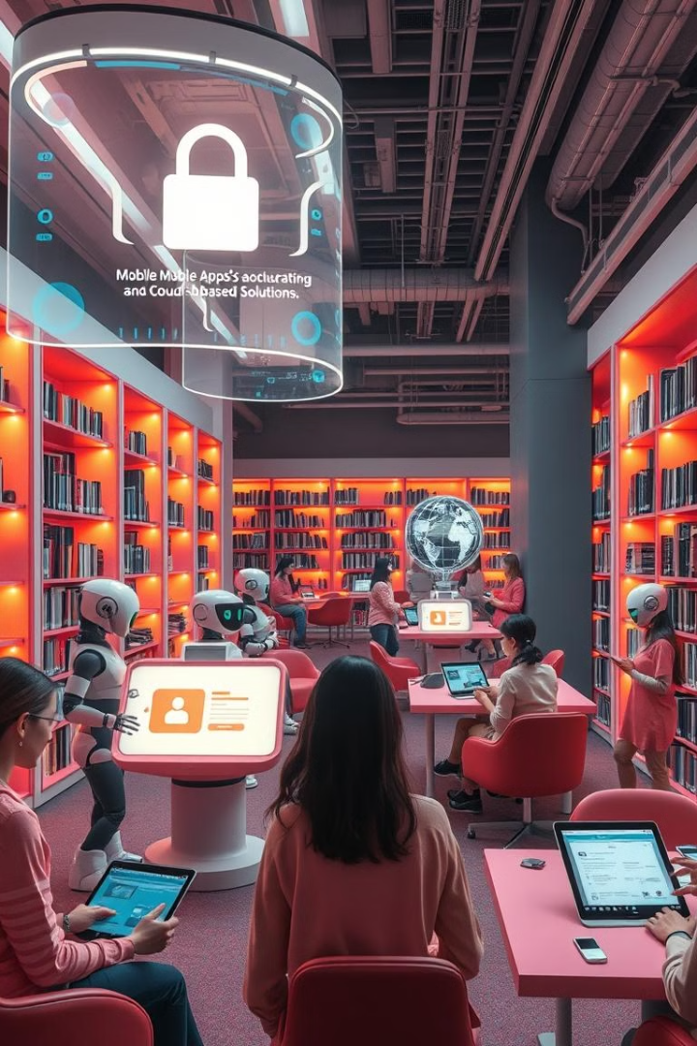



Conclusion and Future Enhancements
Web-based Access
Provide a web-based interface for patrons to access the library's resources remotely.
Mobile App
Develop a mobile application for patrons to manage their accounts and check out books on the go.
Cloud Integration
Explore cloud-based solutions to enhance the scalability and accessibility of the library management system.

